Slide 1
SAAS
SALES ANALYTICS
By: Biyan Bahtiar Ramadhan

Slide 2
TABLE OF CONTENTS
01
02
03
04
05
06
BACKGROUND
PROBLEM
METHODOLOGY
ANALYSIS
RECOMMENDATION
DASHBOARD

Slide 3
PEOPLEU BACKGROUND
B2B Software as a Service (SaaS) company that offers a human resource management application.
Subscription-based.
Currently focus on increasing customer.

Slide 4

PeopleU always held a regular four month discount for new user
Starting in 2021, every January, April, July and October there is 10% discount, but not for extending customer.
In 2022, the discount is 10% higher.

Slide 5
IN Q1 AND Q2 2022 MANY COMPANY DO FINANCIAL EFFICIENCY. DOES THIS AFFECT PEOPLEU PERFORMANCE?

Slide 6
METHODOLOGY
QUERY DATASET
DATA CLEANING & ADDING FEATURE
ANALYSIS & VISUALIZATION
The data is stored in bigquery, containing 9 tables.
This step is done in Google Colab. Added some feature for easier analysis.
This step is done in Tableau

Slide 7
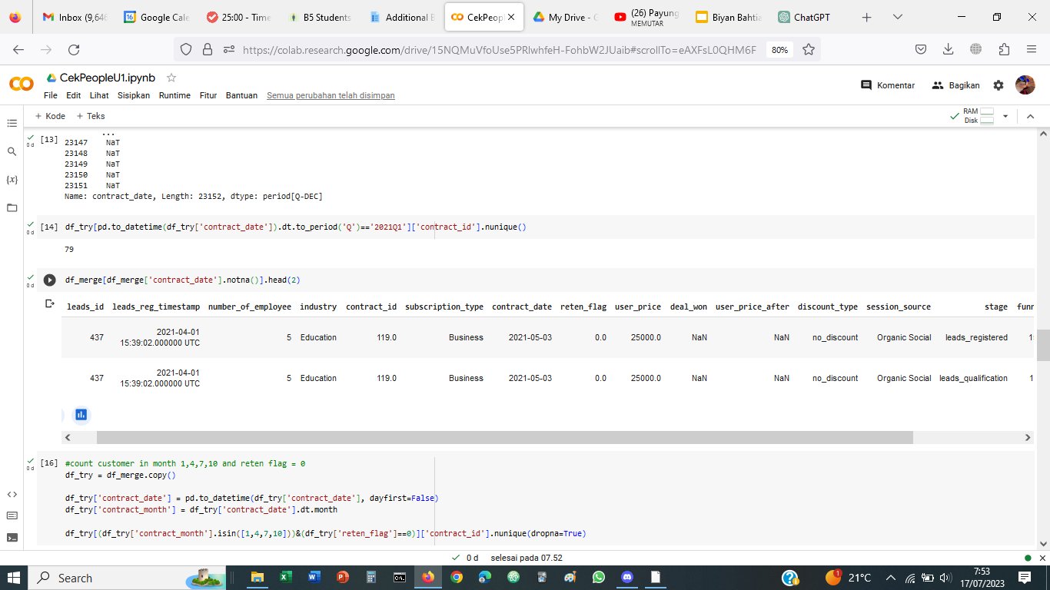
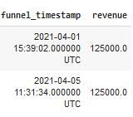
DATASET OVERVIEW

Slide 8
EXPLORATORY DATA ANALYSIS
V

Slide 9
Rp 2.830.627.500
1.226
3.635
Total Revenue From 2021 to 2022
Total Customer From 2021 to 2022
Total Registered Leads From 2021 to 2022

Slide 10
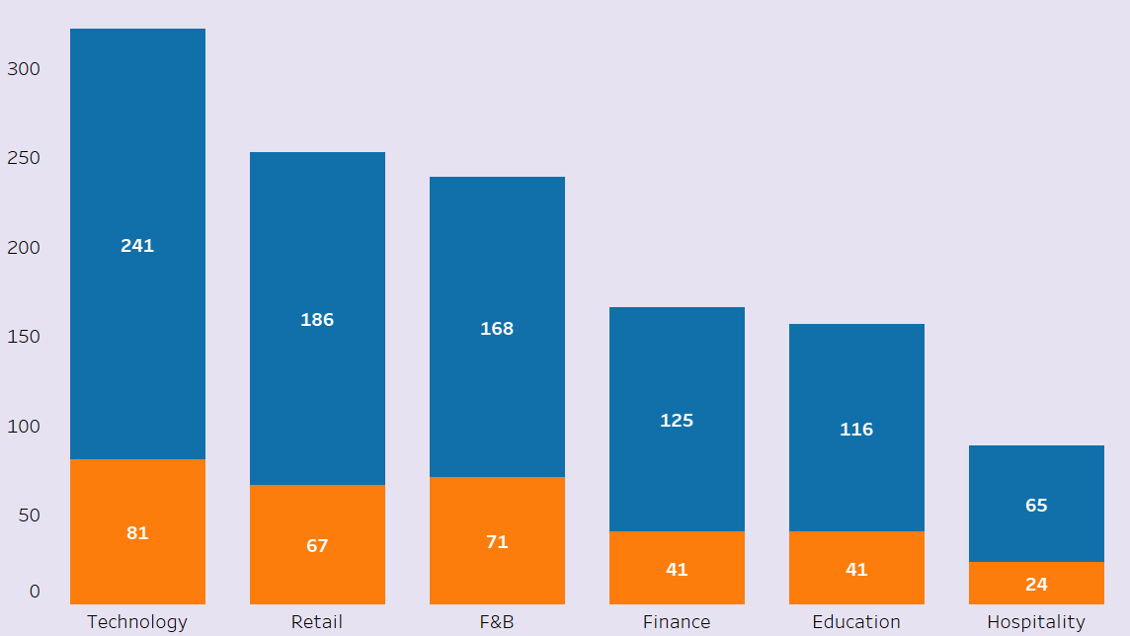
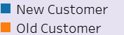
PEOPLEU CUSTOMER MOSTLY COME FROM TECH INDUSTRY

Slide 11
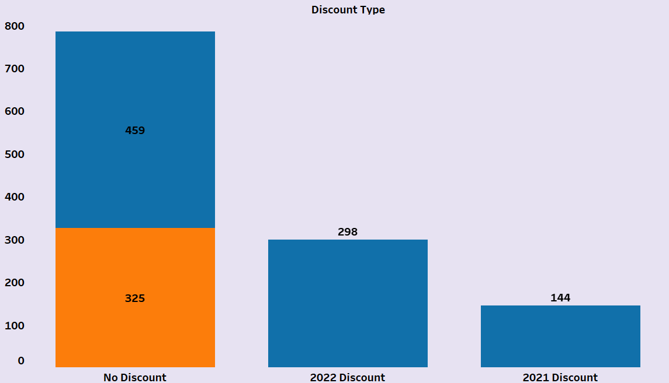
MOST CUSTOMERS ARE NOT USING DISCOUNT

Slide 12
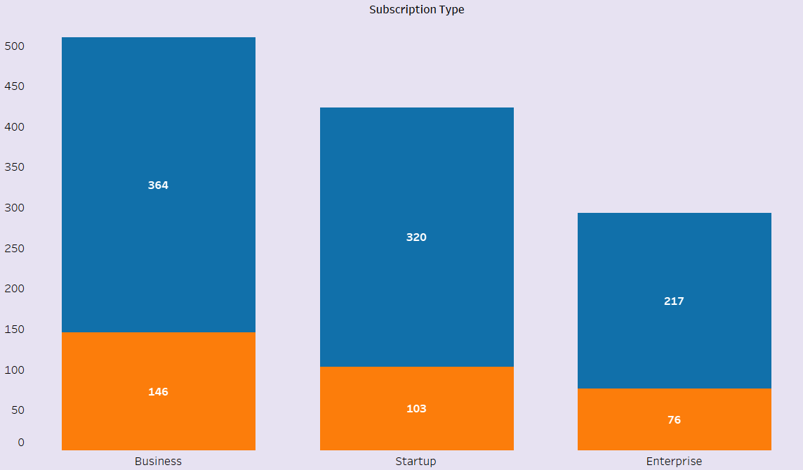
MOST CUSTOMERS ARE PURCHASING BUSINESS SUBSCRIPTION TYPE

Slide 13
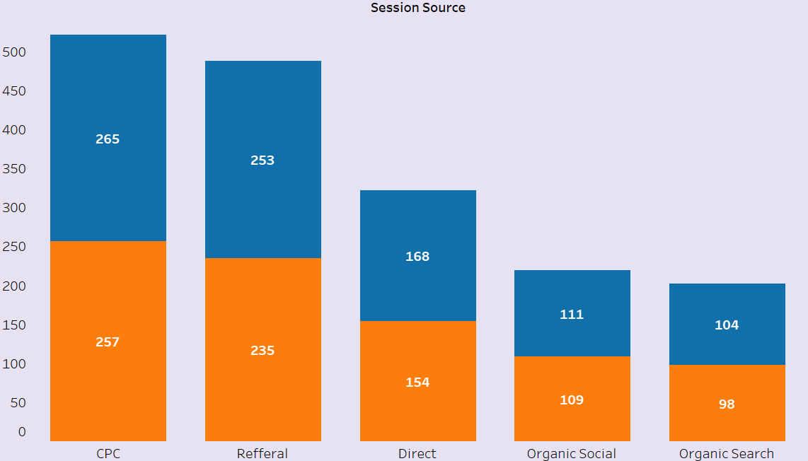
MOST CUSTOMERS CAME FROM COST PER CLICK ADS (CPC) AND REFERRAL

Slide 14
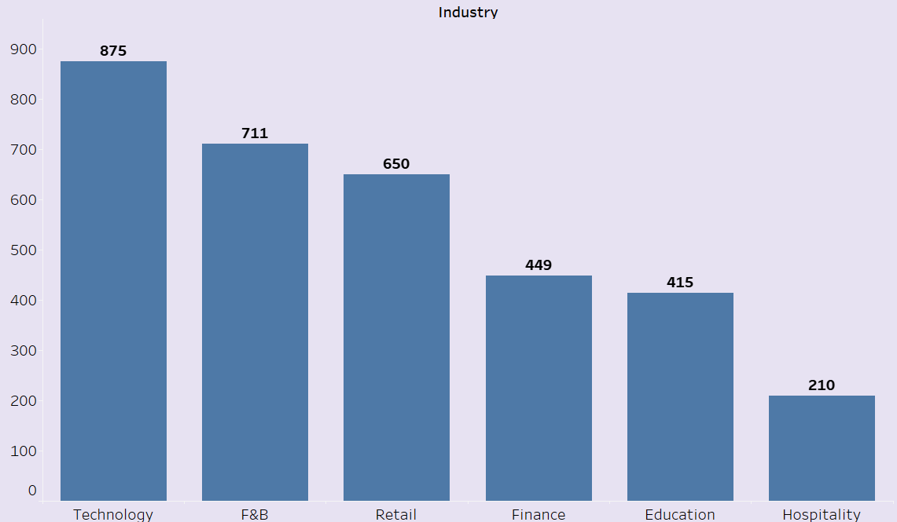
MOST LEADS CAME FROM TECH INDUSTRY

Slide 15
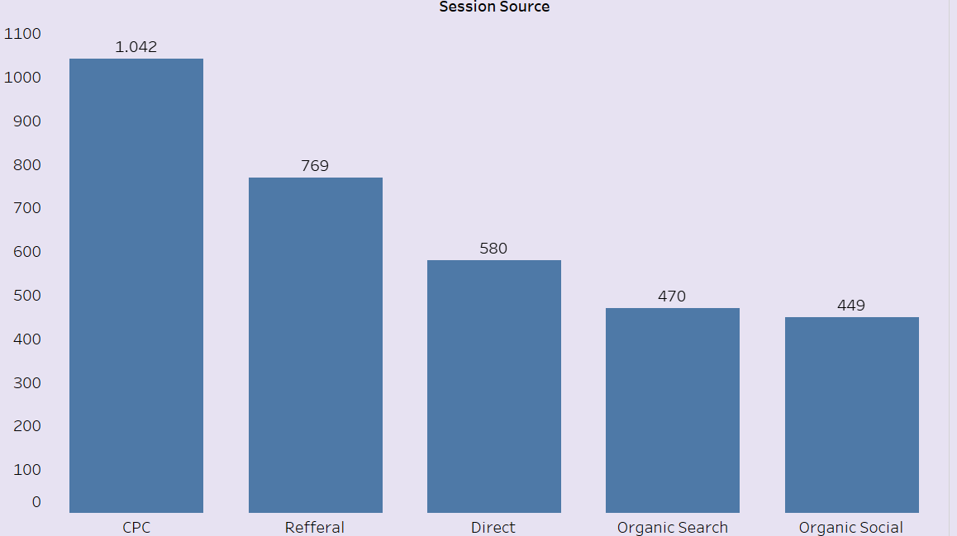
MOST LEADS CAME FROM CPC AND REFERRAL

Slide 16
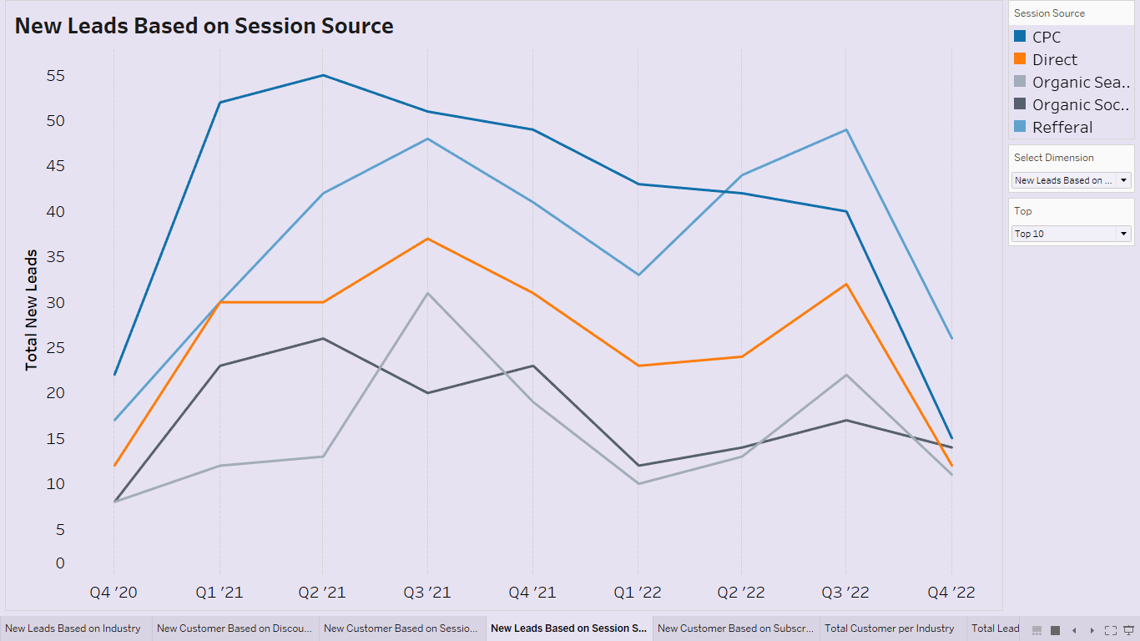
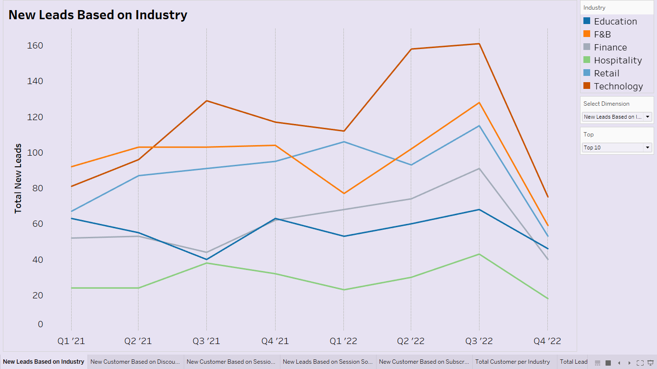
REGISTERING LEADS ARE INCREASING OVER TIME BUT THERE IS A HUGE DROP AT Q4 2022, FROM ALL INDUSTRY AND FROM ALL SOURCE. LEADS CAME FROM CPC ARE DECREASING THE MOST

Slide 17
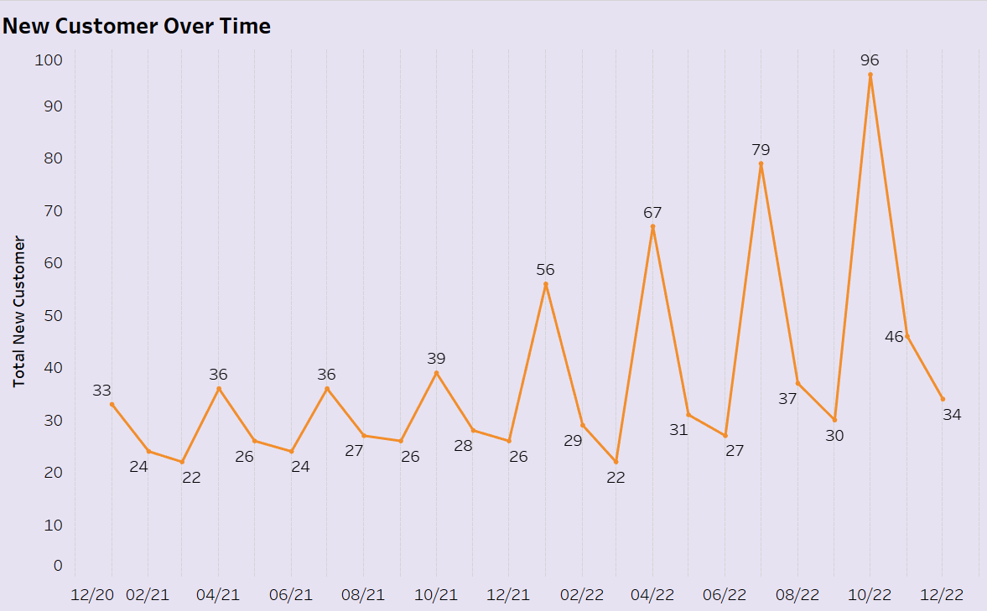
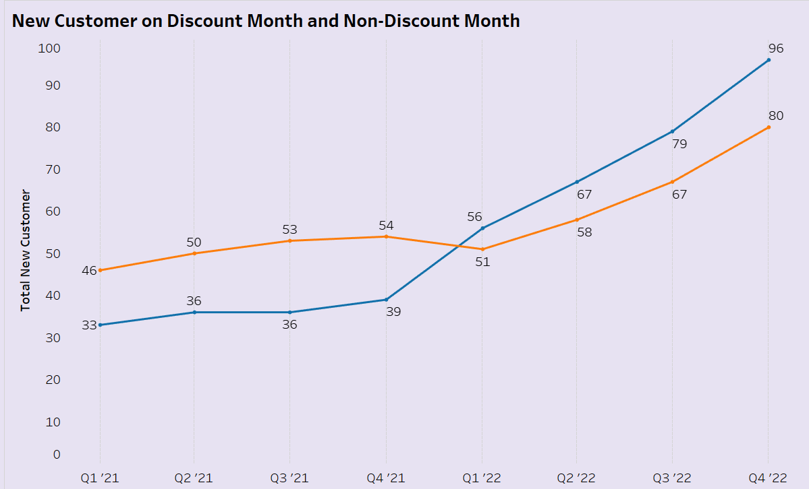
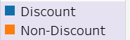
NEW CUSTOMER ARE MORE DRAWN TO SUBSCRIBE IN DISCOUNT MONTH, AND AFTER Q4 2021, THERE ARE MORE NEW CUSTOMER SUBSCRIBING IN DISCOUNT MONTH THAN NON-DISCOUNT MONTH.

Slide 18
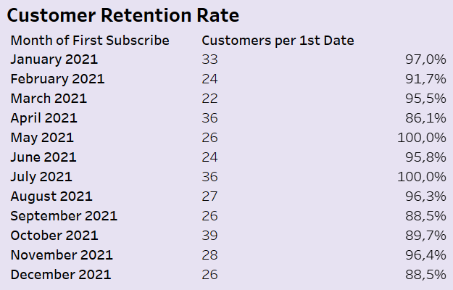
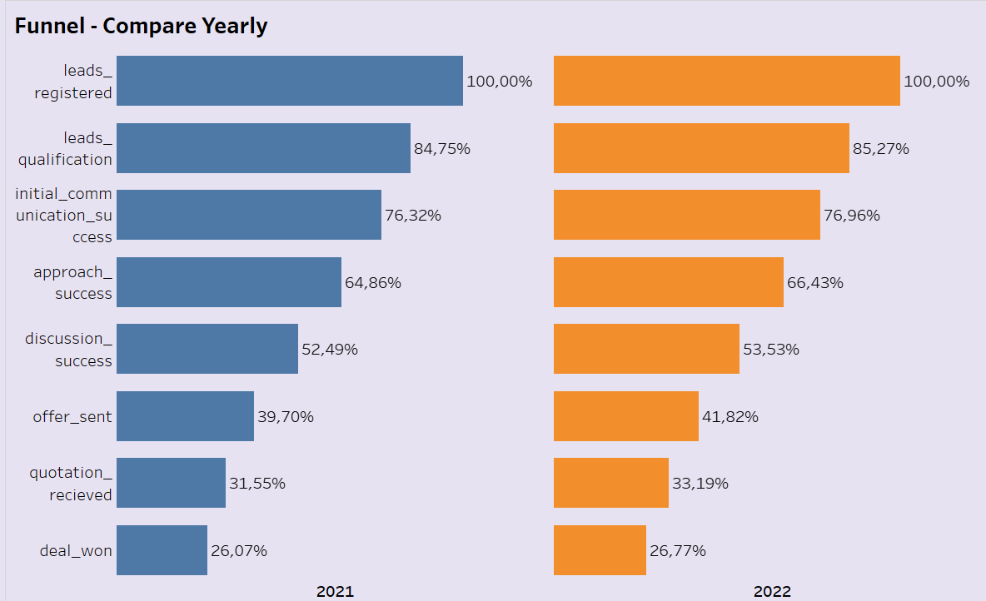
AVERAGE CUSTOMER RETENTION RATE IS 94.7% AND THERE IS STILL NO DIFFERENCE IN CUSTOMER CONVERSION RATE IN 2021 AND 2022

Slide 19
RECOMMENDATION
DEPRIORITIZE MARKETING USING CPC ADS
Focus on direct and referral
CONSIDER GIVING DISCOUNT ON EXTENDING CUSTOMER
If customer next year is churning because subscription price, consider giving discount to maintain retention rate
MONITOR THE PERFORMANCE USING DASHBOARD

Slide 20

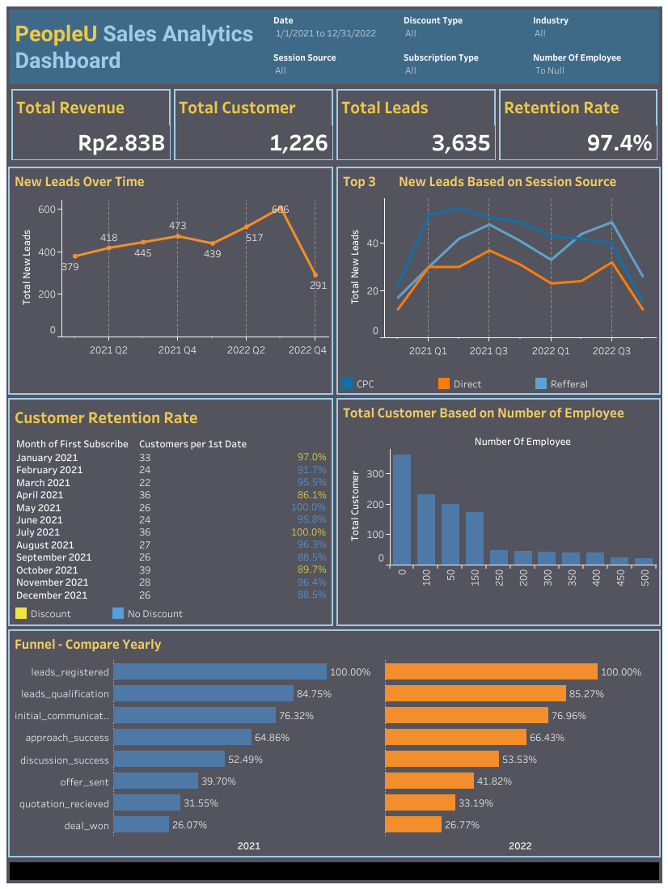
DASHBOARD (LINK)
The dashboard is created to support sales analytics for Sales Manager.
As it is focused on analytics, I design it to be flexible and to facilitate comparison between dimensions.

Slide 21
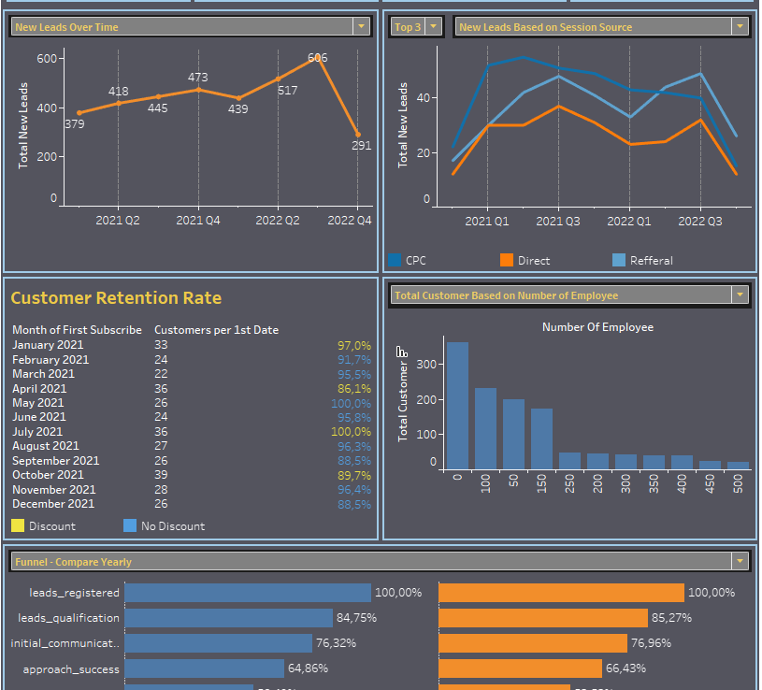

DASHBOARD (LINK)
In one page users can choose a lot of visualization by simply clicking the dropdown menu!

Slide 22
THANKS!
Do you have any questions?
Reach me out on:
biyan.bahtiar@gmail.com
linkedin

